Slide 1

GRADUATE RESEARCH FELLOWSHIP PROGRAM
Information for Prospective NSF REU Applicants
This Photo by Unknown Author is licensed under CC BY-SA-NC

Slide 2
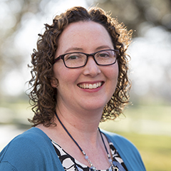
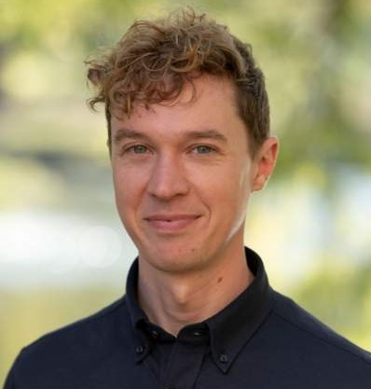
FELLOWSHIP ADVISORS
Texas State’s Coordinating Officials (COs) for NSF GRFP
advise Fellows on GRFP policies and procedures
manage awards – stipend and tuition payments
certify satisfactory academic progress
submit reports to NSF (status, completion, financial)
Dr. Andrea Hilkovitz
Dr. Brian Smith
External Funding Coordinator,
The Graduate College
External Funding Coordinator,
The Graduate College

Slide 3
TABLE OF CONTENTS
INTRODUCTION
ELIGIBILITY
APPLICATION
RESOURCES
NSF mission & GRFP goals
Program details
Award information
Citizenship
Degree requirement
Field of study
Components
Deadlines
Tips
GRFP websites
Next steps
Q&A

Slide 4
NATIONAL SCIENCE FOUNDATION (NSF)
Independent federal agency created in 1950
Mission:
to promote the progress of science
to advance the national health, prosperity, and welfare
to secure the national defense
Funds ~20% of all federally supported basic research conducted by U.S. colleges and universities
Goals of Graduate Research Fellowship Program (GRFP):
to select, recognize, and support individuals with the potential to be high-achieving scientists early in their careers
to broaden participation in STEM of underrepresented groups

Slide 5

PROGRAM DETAILS
The program recognizes and supports outstanding graduate students who are pursuing full-time research-based master’s and doctoral degrees at U.S. institutions (award is portable).
The GRFP provides three years of support for the graduate education of individuals who have demonstrated potential for significant research achievements in STEM, STEM education, and some social science fields.
NSF especially encourages women, members of groups historically underrepresented in STEM, persons with disabilities, veterans, and undergraduate seniors to apply.
High priority research areas: Artificial Intelligence, Quantum Information Science, & Computationally Intensive Research.
This Photo by Unknown Author is licensed under CC BY-NC

Slide 6

AWARD INFORMATION
$138,000
$34,000 STIPEND
$12,000 COE ALLOWANCE
2,000+
AWARDEES PER YEAR
12,000+
APPLICATIONS PER YEAR
~16%
ACCEPTANCE RATE
This Photo by Unknown Author is licensed under CC BY

Slide 7

ELIGIBILITY
There are three eligibility requirements:
Citizenship
Degree
Field of Study

Slide 8

CITIZENSHIP REQUIREMENT
You must be a U.S. citizen, national, or permanent resident.
Foreign nationals who are in the U.S. on a student visa (international students) are not eligible to apply.
Eligibility with respect to citizenship must be certified at the time of application.
Undocumented students are currently ineligible.
This Photo by Unknown Author is licensed under CC BY-SA-NC

Slide 9
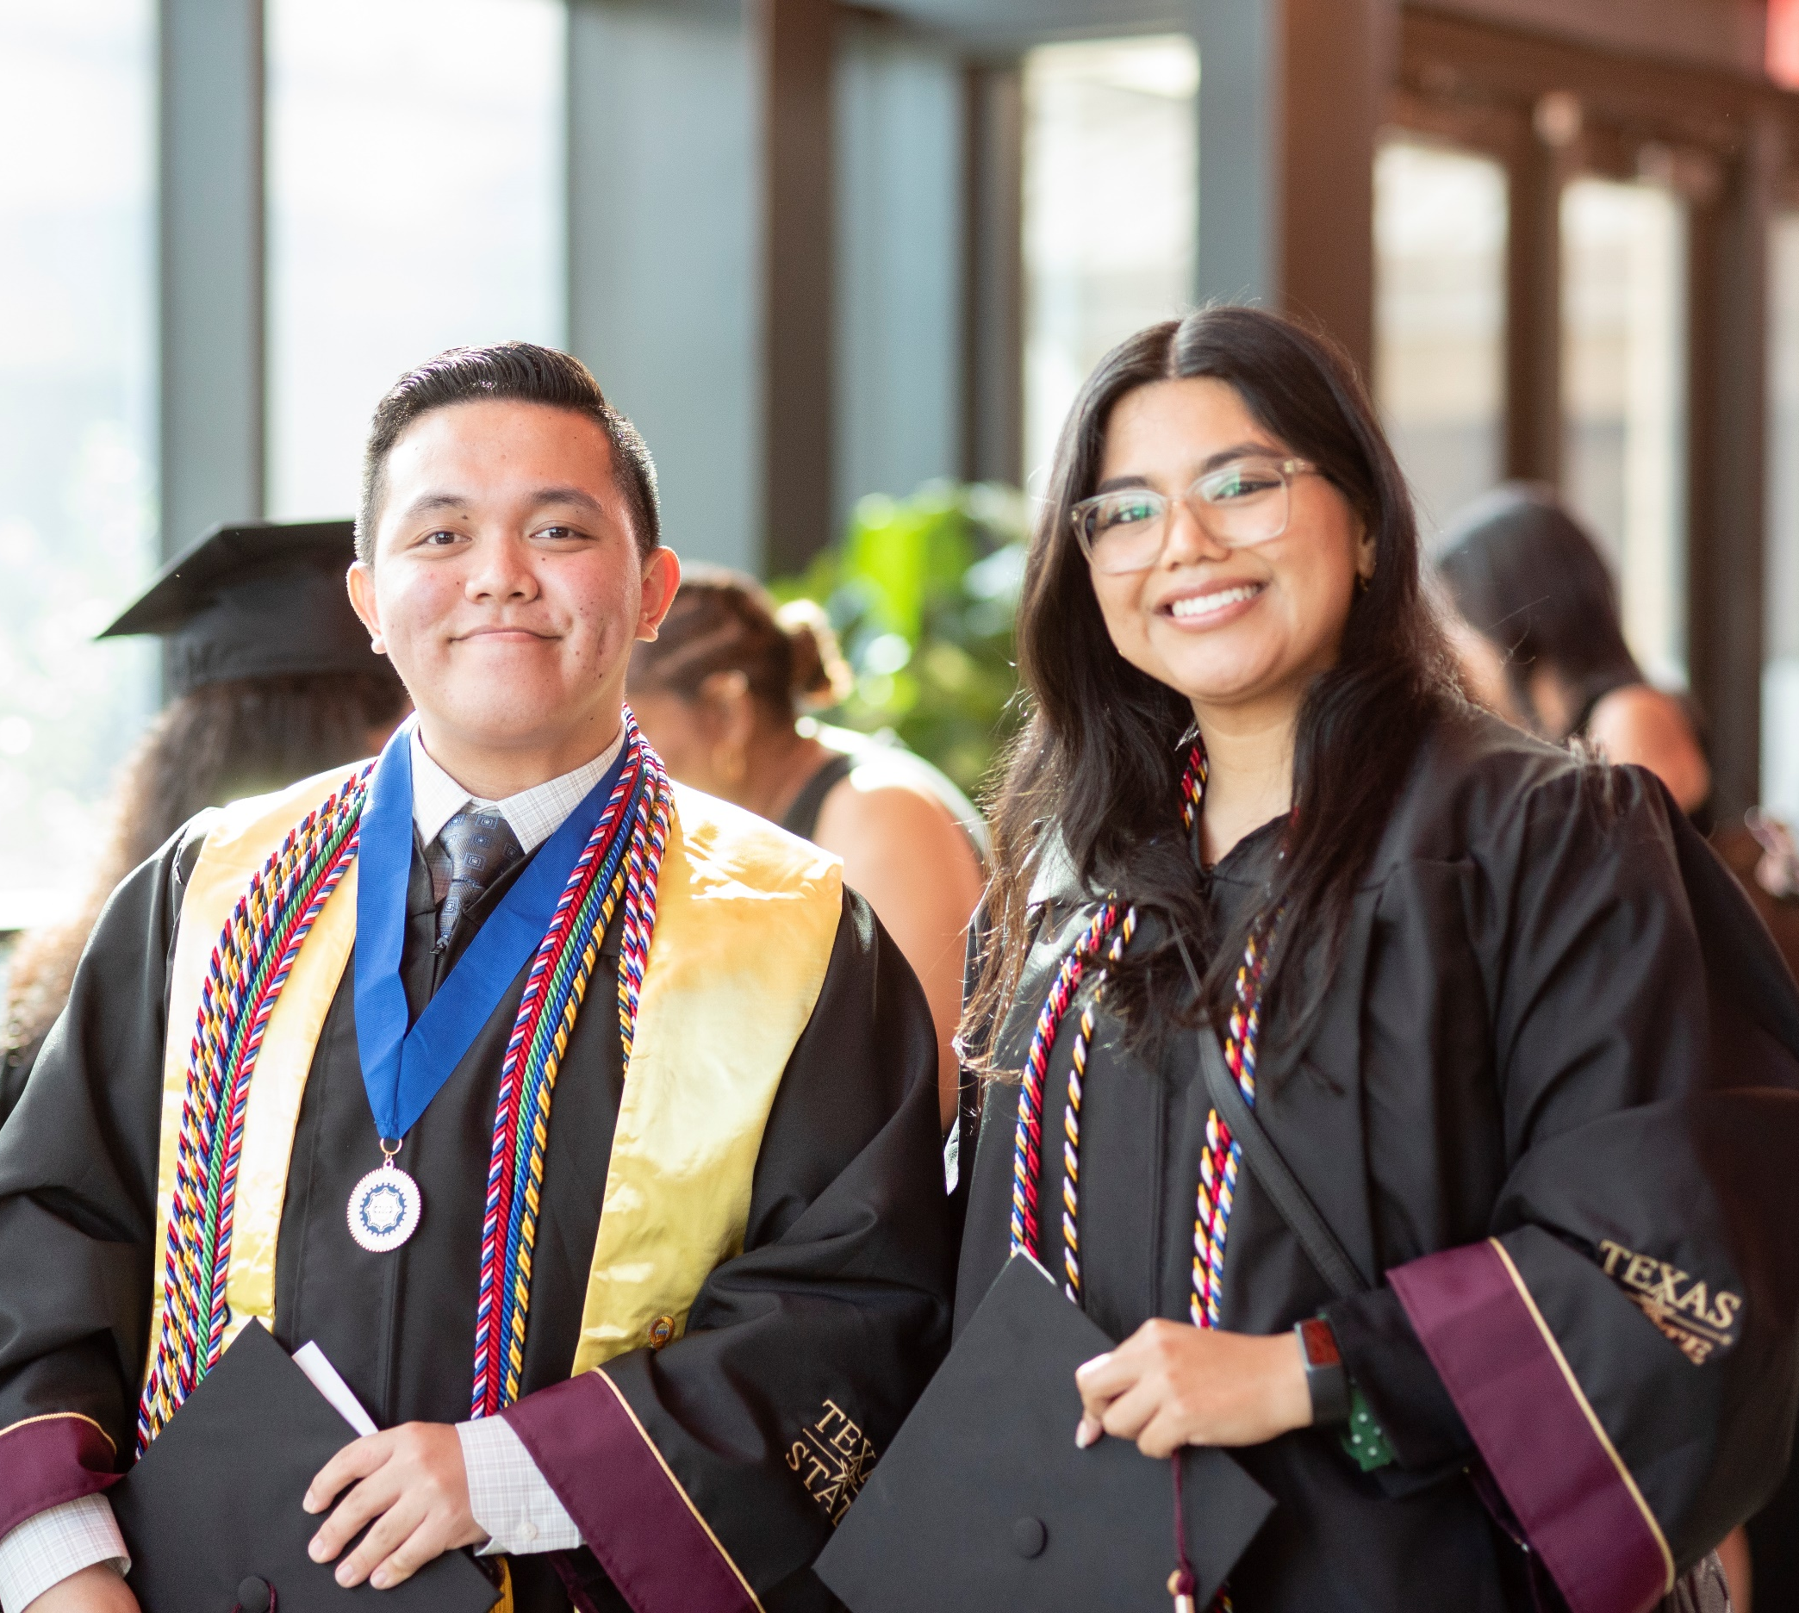
DEGREE REQUIREMENT
You are eligible to apply:
before beginning graduate school
as an undergraduate senior
as a bachelor’s degree holder
Note: Individuals applying while enrolled in a joint bachelor's-master's degree program are considered graduate students who a) must have completed three (3) years in the joint program and b) are limited to one application to GRFP. They are not eligible to apply again as doctoral students.
after enrollment in graduate school
as a first-year graduate student
as a second-year graduate student

Slide 10
UNDERGRADUATE APPLICANTS
Undergraduate students apply in the fall of the academic year in which they anticipate receiving a bachelor’s degree.
For the 2023 competition…
You will be a senior undergraduate student in fall 2022, or you are currently in your final year of undergraduate study.
You are on track to receive a bachelor’s degree before fall 2023 (December 2022, May 2023, August 2023).
You are a bachelor’s degree holder (post-baccalaureate) and you have no graduate study.
You are applying to graduate school for fall 2023.
You will be accepted to a graduate program by May 1, 2023.

Slide 11
NEW(ISH) RULE: NUMBER OF APPLICATIONS
Effective as of the 2017 competition, graduate students are limited to only one application, EITHER in their first year OR in their second year of graduate school.
Rule does not affect undergraduate students. You may still apply as an undergraduate and/or post-bac student and apply again as a graduate student if you are not awarded a GRFP.
The purpose is to recruit diverse cohorts; the undergraduate population in STEM is more diverse than graduate population.
Undergraduate applications had fallen from 41% to 25% of the applicant pool since 2001.
Graduate students should consult with their advisors about the timing of their applications to determine in which year to apply.

Slide 12
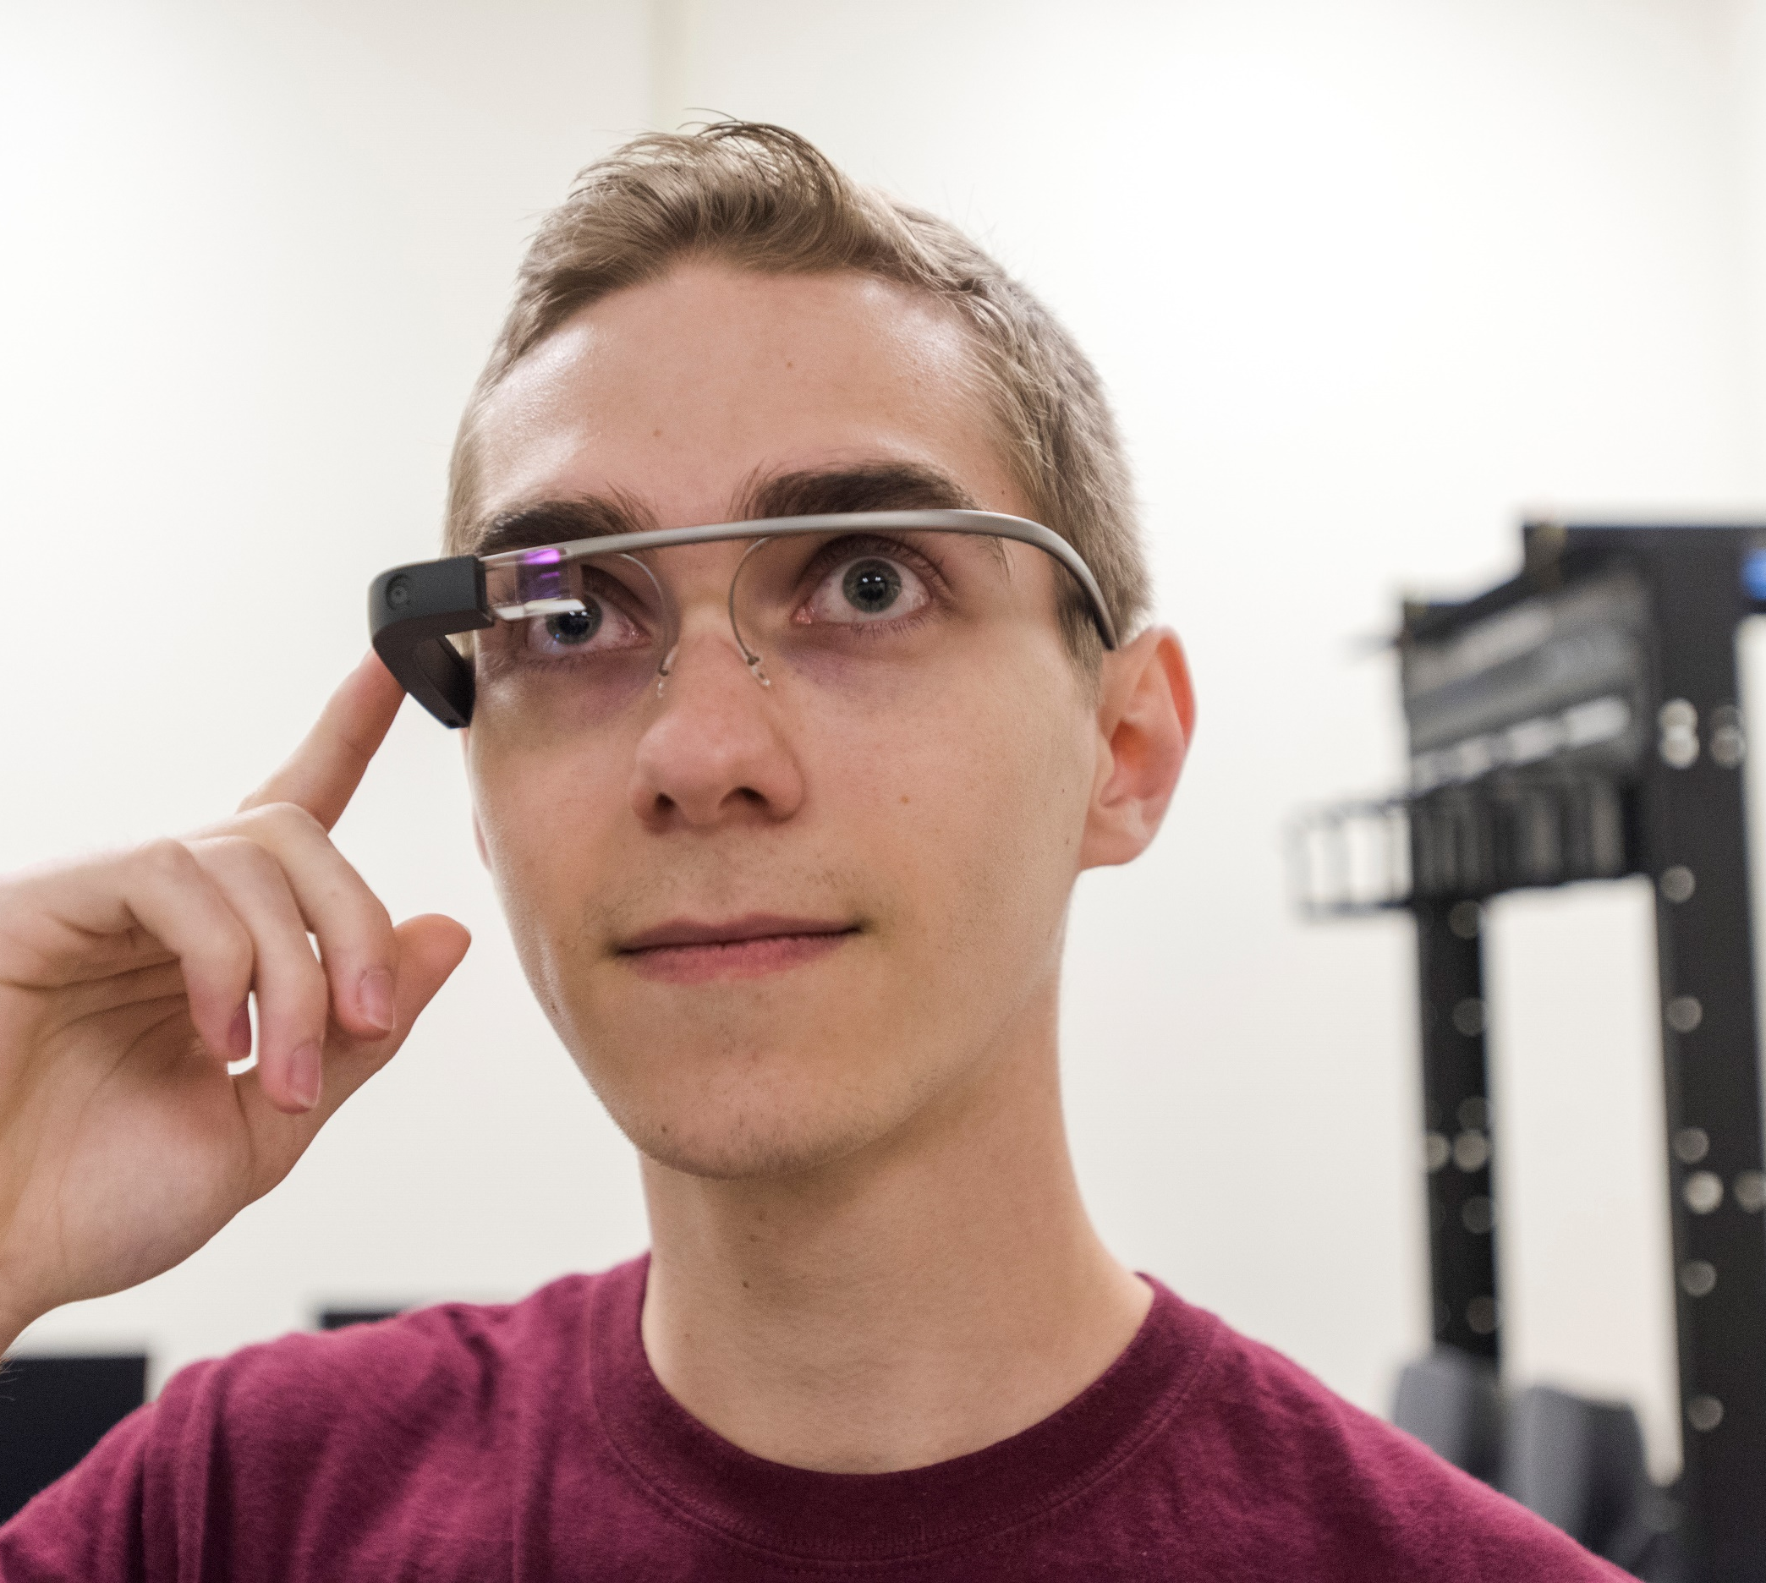
FIELD OF STUDY REQUIREMENT
The following programs and areas of study are ineligible:
practice-oriented professional degree programs, such as medical, law, business, physical therapy, and social work (MD, DDS, JD, MBA, DPT, MSW, MPH; also MD/PhD)
professional degree programs and graduate programs that are primarily course-based (no thesis)
clinical practice or patient-oriented degree programs, such as nursing, counseling, and health services research
biomedical research and research using animal models of disease (etiology, pharmacology, epidemiology)
Exception: biomedical engineering

Slide 13
SUPPORTED FIELDS OF STUDY
Science, Technology, Engineering, and Mathematics
Chemistry
Computer and Information Sciences and Engineering
Engineering
Geosciences
Life Sciences (Biology, Biochemistry, Ecology)
Materials Research
Mathematical Sciences
Physics and Astronomy
Psychology
STEM Education
Social Sciences

Slide 14
CISE SUBFIELDS
Algorithms and Theoretical Foundations
Artificial Intelligence
Bioinformatics and other Informatics
Communication and Information Theory
Computational Science and Engineering
Computationally Intensive Research
Computer Architecture
Computer Networks
Computer Security and Privacy
Computer Systems and Embedded Systems
Data Mining & Information Retrieval
Data Science
Databases
Formal Methods, Verification, and Programming Languages
Graphics and Visualization
Human Computer Interaction
Machine Learning
Natural Language Processing
Quantum Computing and Communication
Quantum Information Science
Robotics and Computer Vision
Software Engineering
CISE, other (specify)

Slide 15

APPLICATION COMPONENTS
Application form (https://www.research.gov/grfp/Login.do):
Personal Information
Education, Work and Other Experience
Academic Honors, Publications, and Presentations
Proposed Field of Study and Graduate School
Electronic transcripts – undergraduate and graduate transcripts
References (3) – names and email addresses of letter writers
2-page letters uploaded by references
Two statements:
Personal, Relevant Background and Future Goals (3 pages)
Graduate Research Plan (2 pages)
This Photo by Unknown Author is licensed under CC BY-NC

Slide 16

APPLICATION DEADLINES
All applications must be received by 5 p.m. local time
Deadlines* are determined by primary field of study:
Monday, October 17
Life Sciences
Tuesday, October 18
Computer and Information Science and Engineering, Materials Research, Psychology, Social Sciences, STEM Education and Learning
Thursday, October 20
Engineering
Friday, October 21
Chemistry, Geosciences, Mathematical Sciences, Physics
*estimated deadlines for FY2023 competition
This Photo by Unknown Author is licensed under CC BY

Slide 17
APPLICATION TIPS
Seek out research experiences – the single best indicator of preparation for graduate study (additional REU, volunteer or paid lab positions, honors thesis, senior project)
Start planning early, and aim to apply first as an undergraduate student to maximize chances and get feedback
Build relationships with faculty and other mentors in your field
Get assistance with your application – none of our students win without mentoring
Don’t wait until the application opens – work on your application during the summer
Engage in the application process for the sake of learning about yourself and your research interests – not solely to win most of our “unsuccessful” applicants get into graduate school using their GRFP application materials, many to their dream schools and with offers of full funding

Slide 18

PROGRAM WEBSITES
https://www.nsfgrfp.org/
Application Tutorial
Screenshots
Helpful Tips
FAQs
Reference Writers – Requirements, Tutorial, Tips, FAQs
https://www.research.gov/grfp/Login.do
Solicitation (21-602)*
Award Offers and Honorable Mentions List
Institution Directory
* FY 2023 solicitation expected in late July
This Photo by Unknown Author is licensed under CC BY-NC

Slide 19

NEXT STEPS
Texas State students:
Let me know you’re interested in applying!
Sign up to attend a mandatory information session
3. Follow steps to join campus application process, including access to Canvas site and virtual boot camp
Other students:
1. Find out about support on your home campus!
Email Dr. Hilkovitz at gcexternalfunds@txstate.edu for information about the offices, fellowship advisor(s), and other support staff that may be able to assist you

Slide 20
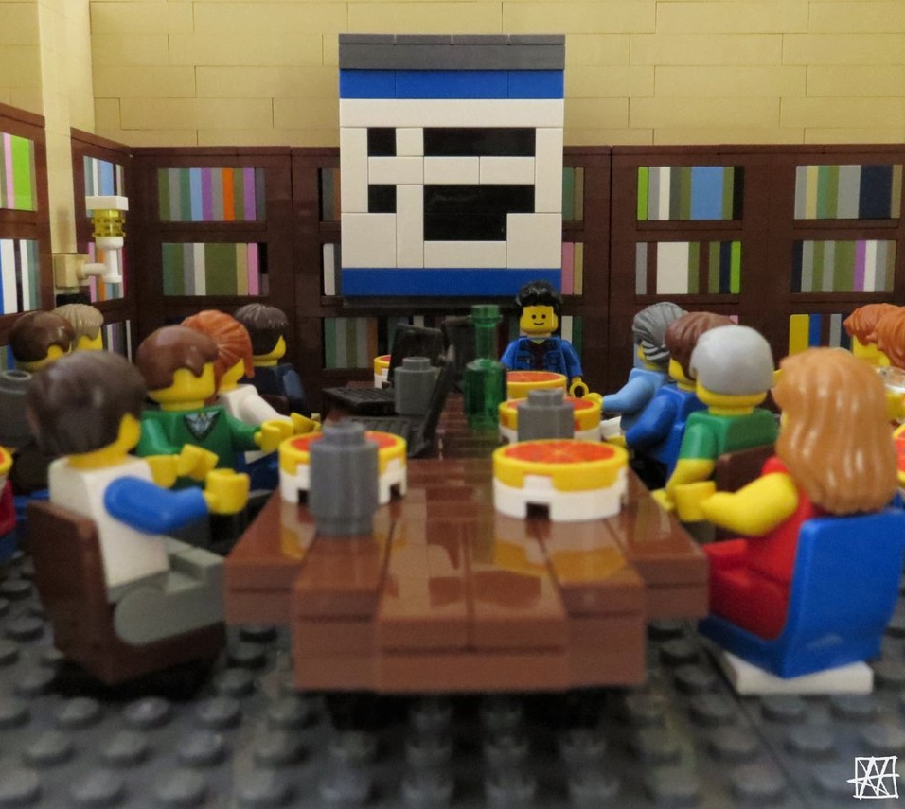
QUESTIONS?

